Slide 1

Chapter 3 exercise

Slide 2





catalogue

Slide 3
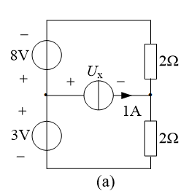
3-21 Find U_{x} and I_{x} using superposition theorem.

Slide 4
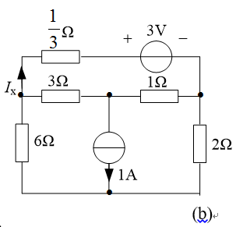
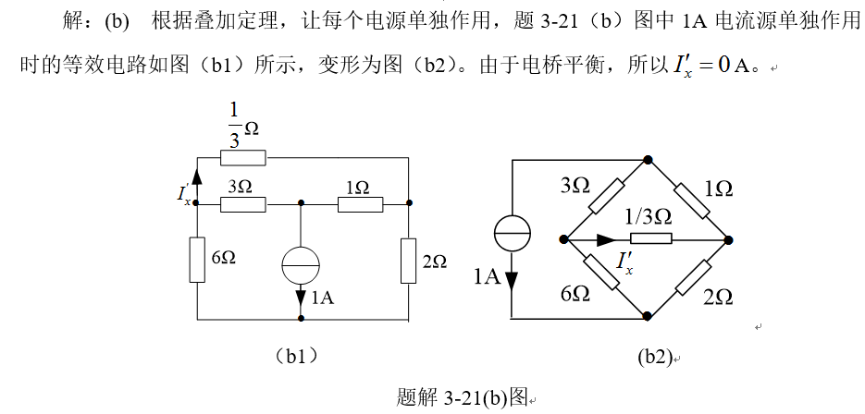
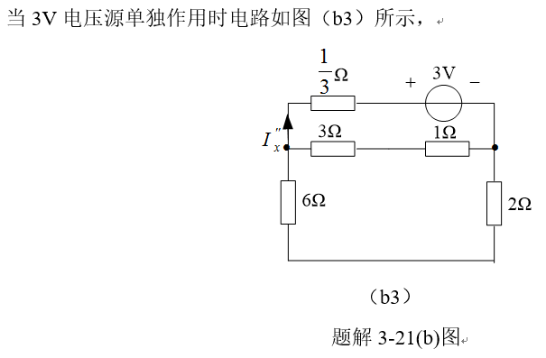
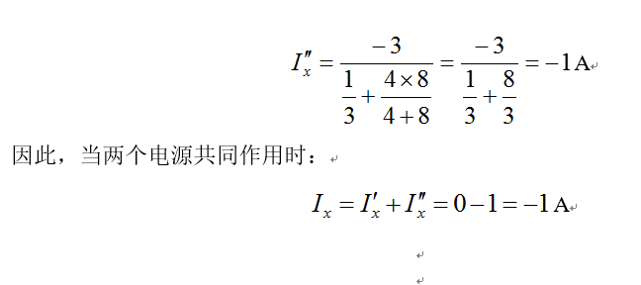

Slide 5
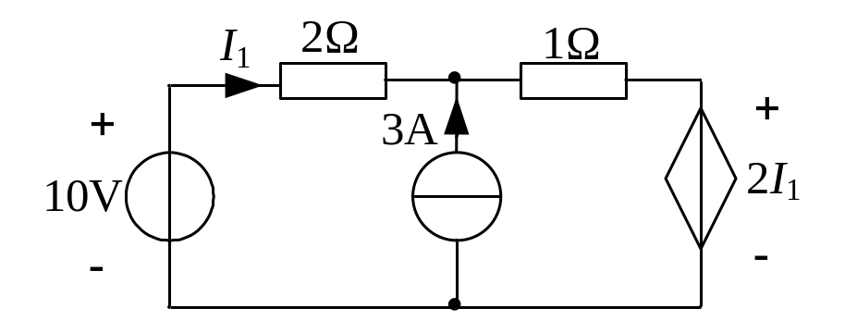
3-22 Find I₁ using superposition theorem.

Slide 6
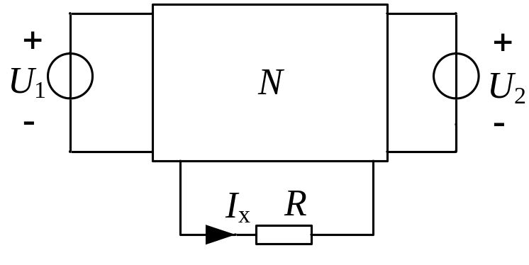
3-25 The circuit is shown in the figure 3-25. (1) N is only composed of linear resistor, if U₁=2V,U₂=3V, I_{x}=20A; and if U₁=2V,U₂=1V, I_{x}=0, find the value of I_{x} when U₁=U₂=5V. (2) If N included independent source, When U₁=U₂=0, I_{x}=-10A, and the condition of (1) is still applicable to N, find I_{x} when U₁=U₂=5V.

Slide 7
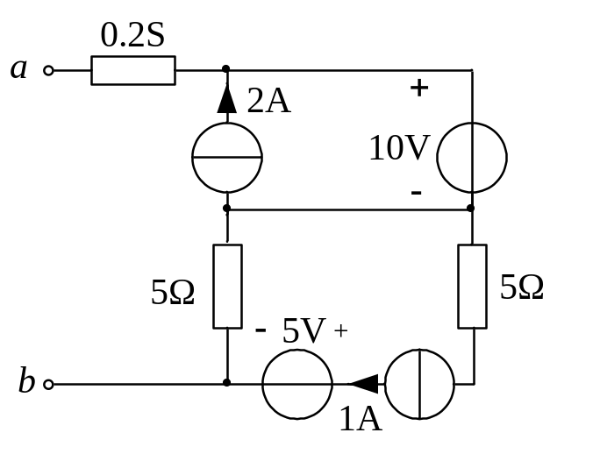
3-26 Find Thevenin equivalent circuit or Norton equivalent circuit for A-B port of each circuit in figure 3-26.

Slide 8
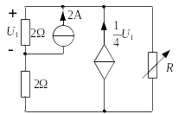
3-30In the circuit shown in the figure 3-30, R is variable. Let us find R for maximum power transfer and the maximum power transferred to this load.

Slide 9
Thanks!

